Slide 1
CHAPTER 3
MEMORY MANAGEMENT

Slide 2
Introduction
Memory is an important resource that must be carefully managed.
Why is memory so important?
Most machine instructions take memory addresses as arguments but none take disk addresses
  ⇒ Any instruction in execution and any data being used by the instructions must be in memory
And why is the management so crucial ?
Even though the amount of memory used in computers are increasing remarkably, programs are getting bigger faster than memories - programs expand to fill the memory available to hold them.
To improve both the utilization of CPU and the speed of its response to users, computers must keep as many as possible processes in memory.

Slide 3
Introduction
Programmers usually would like
  an infinitely large
  inexpensive
  infinitely fast and
  nonvolatile memory
Unfortunately technology does not provide such memories.
⇒ most computers have a memory hierarchy

Slide 4
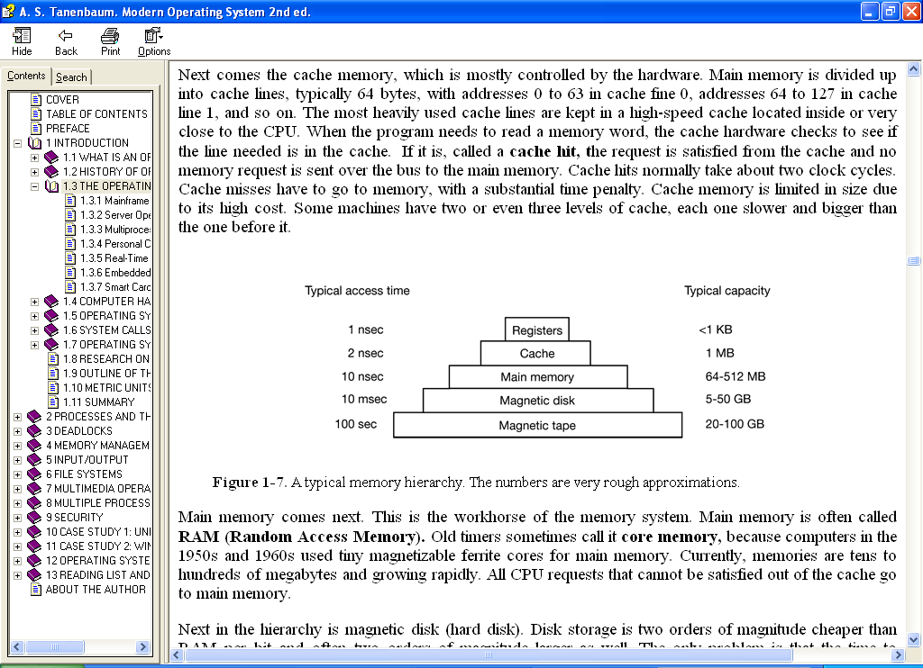
Introduction
It is the job of the operating system to coordinate how these memories are used
The part of the operating system that manages the memory hierarchy is called the memory manager.
<1KB
Up to 2 MB
Up to 4 GB
Up to 600GB
20-100 GB

Slide 5
Introduction
The job of the memory manager is to
    keep track of which parts of memory are in use
    to keep track of which parts are not in use
    to allocate memory to processes when they need it
    to de-allocate memory when processes are done and
    to manage swapping between main memory and disk when main memory is too small to hold all the processes
In general memory management is intended to satisfy :
  Relocation – translating memory references found in the code of the program in to actual physical memory addresses, reflecting the current location of the program in memory

Slide 6
Introduction
  Protection – protecting each process against unwanted interference by other processes whether intentional or accidental
    A bit difficult job because
      relocation makes it difficult to check absolute address
      Most languages allow dynamic address calculation
    Handled by the processor not the OS – permissibility of an address is checked at the time of execution of the instruction
  Sharing – flexibility to allow several processes to access the same portion of main memory without compromising essential protection ( e.g cooperating processes)
  Logical Organization
  Physical Organization

Slide 7
Memory Management Techniques
There are several techniques
Monoprogramming - just run one program at a time, sharing the memory between that program and the operating system.
  User types a command
  The OS copies the requested program from disk to memory and executes it.
  The OS displays a prompt character and waits for a new command when the process finishes
    Except on simple embedded systems, monoprogramming is hardly used any more

Slide 8
Techniques
Fixed Partitioning
  Divide memory into partitions at boot time
  Simple but has internal fragmentation
Dynamic Partitioning
  Create partitions as programs loaded
  Avoids internal fragmentation, but must deal with external fragmentation
Simple Paging
    Divide memory into equal-size pages, load program into available pages
  Pages do not need to be consecutive
  No external fragmentation, small amount of internal fragmentation

Slide 9
Techniques
Simple Segmentation
    Divide program into segments
  Each segment is contiguous, but different segments need not be
  No internal fragmentation, some external fragmentation
Virtual-Memory Paging
  Like simple paging, but not all pages need to be in memory at one time
  Allows large virtual memory space
  More multiprogramming, overhead
Virtual Memory Segmentation
  Like simple segmentation, but not all segments need to be in memory at one time
  Easy to share modules
  More multiprogramming, overhead

Slide 10
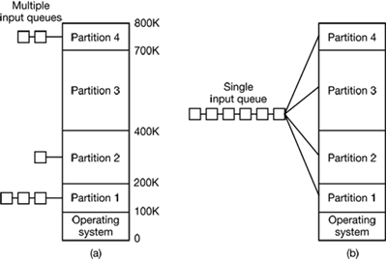
Fixed Partioning
Multiprogramming with Fixed Partitions - allow multiple processes to run at the same time by simply dividing memory up into n (possibly unequal) partitions.
    Can be done manually when the system is started up.
    increases the CPU utilization.
    When a job arrives, it can be put into the input queue for the smallest partition large enough to hold it.
    Since the partition sizes are fixed in this scheme, any space in a partition not used by a job is lost and this is known as internal fragmentation.

Slide 11
Fixed Partitioning
    E.g. OS/360 on large IBM mainframes ➔ MFT (Multiprogramming with a Fixed number of Tasks or OS/MFT).
    Limitations
    Since partition sizes are fixed, larger programs should be split the program into pieces, called overlays. Overlay 0 would start running first. When it was done, it would call another overlay.
    ➔ done by the programmer and was time consuming and boring.
    The degree of multiprogramming (number of active process in memory) is limited by the number of slots defined.
    The degree of internal fragmentation is high

Slide 12
Dynamic Partitioning
Multiprogramming with Dynamic Partitions- use a variable number and size of partitions .
  When a process is brought in to main memory, it is allocated exactly as much memory as it requires and no more.
  Starts out well, but eventually leads to a situation in which there are a lot of small holes in memory.
  ➔External fragmentation - memory that is external to all partitions becomes increasingly fragmented.
  Solution is compaction - the OS ,from time to time ,shifts the processes so that they are contiguous and so that all of the free memory is together in one block. ⬅ Quite time consuming.

Slide 13
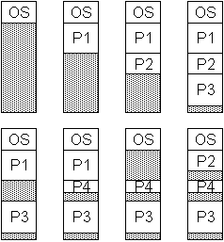
Dynamic Partitioning

Slide 14
Overview of Memory Allocation
Placement
    Best-Fit: Find the smallest available block that will hold the program
      Tends to produce a lot of small blocks
        Use 30K block for 28K program, leaves 2K
    First-Fit: Find the first block that is large enough (regardless of size)
        May leave small blocks at the beginning, larger blocks at the end of memory
    Next-Fit: Like First-Fit, but start from the last allocation instead of the start
        Tends to break up large blocks at the end of memory that First-Fit leaves alone
  ➔First-Fit is generally best and the fastest
Replacement
  Who gets swapped out? ( To be discussed later )

Slide 15
Buddy System
Tries to allow a variety of block sizes while avoiding excess fragmentation
  Blocks generally are of size 2^{k}, for a suitable range of k
  Initially, all memory is one block
  All sizes are rounded up to 2^{s}
  If a block of size 2^{s} is available, allocate it
  Else find a block of size 2^{s+1} and split it in half to create two buddies
  If two buddies are both free, combine them into a larger block
  Seen in parallel systems and Unix kernel memory
  Largely Replaced by paging

Slide 16
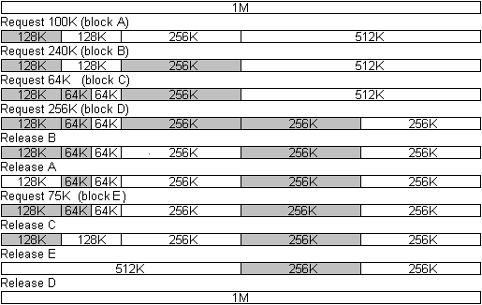
Buddy System

Slide 17
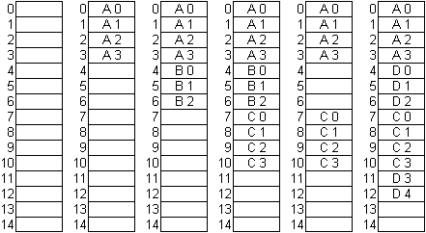
Paging
Divides memory into small (4K or less) pieces of memory (page frames/ frames )
Logically divide program into same-size pieces (pages)
Use a page table to map the pages of the current process to the corresponding frames in memory

Slide 18
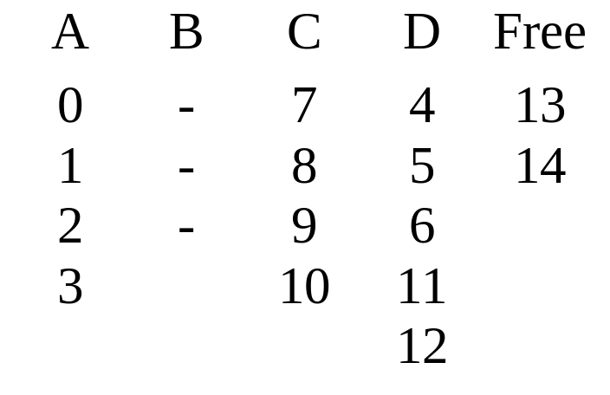
Paging
Page Tables for previous example
  Page size is typically a power of 2 to simplify the paging hardware
    Common sizes: 512 bytes, 1K, 4K

Slide 19
Segmentation
  Program views memory as a set of segments of varying sizes
    Easy to handle growing data structures
    Easy to share libraries, memory
    Privileges can be applied to a segment
    Programs may use multiple segments
    Have a segment table
      Beginning address
      Size
      Present, Modified, Accessed bits
      Permission/Protection bits

Slide 20
Paging and Segmentation
Simple paging is similar to fixed partitioning. The differences are :
    With paging the partitions are rather small and a program may occupy more than one partition
    The partitions need not be contiguous
    The degree of internal fragmentation is small
Simple segmentation is similar to dynamic partitioning. The differences are :
    With segmentation ,a program may occupy more than one partition
    The partitions need not be contiguous
    The degree of external fragmentation is small

Slide 21
Addresses
Two types
  Logical Addresses – generated by the CPU/program
    Is a reference to a memory location independent of the current location of data in memory
    Often set as relative to the program start
  Physical Addresses –actual location in memory
    As seen by memory
Hardware does address conversion

Slide 22
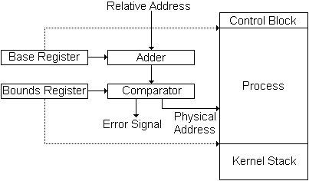
Addresses
Base Register
  Holds beginning physical address to be added to all program addresses
Bounds Register
  Used to detect accesses beyond the end of the allocated memory
  May have length instead of end address
  Provides protection to system
Relocation requires ➔Changing base/bounds registers

Slide 23
Managing Free/Allocated Memory
When memory is assigned dynamically, the operating system must manage it. In general terms, there are two ways to keep track of memory usage: bitmaps and linked lists.
  Memory Management with Bitmaps - memory is divided up into allocation units, perhaps as small as a few words and perhaps as large as several kilobytes.
    Keep a bitmap corresponding to each allocation unit ithat s a bit in the bitmap,
      Bitmap could be 0 if the unit is free and 1 if it is occupied (or vice versa).
      Problem - when it has been decided to bring a k unit process into memory, the memory manager must search the bitmap to find a run of k consecutive 0 bits in the map.
        a slow operation (because the run may straddle word boundaries in the map).
  Memory Management with Linked Lists- the OS maintains a linked list of allocated and free memory segments

Slide 24
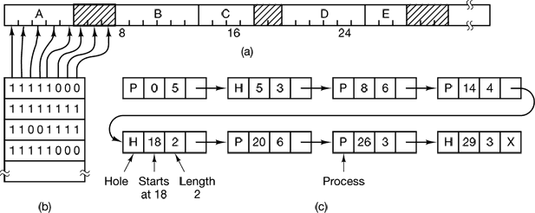
Managing Free/Allocated Memory
A part of memory with five processes and three holes (shaded)
The corresponding bitmap
The same information as a linked list

Slide 25
Virtual Memory
With a batch system, organizing memory into fixed partitions is simple and effective.
  Each job is loaded into a partition when it gets to the head of the queue.
  It stays in memory until it has finished.
  As long as enough jobs can be kept in memory to keep the CPU busy all the time, there is no reason to use anything more complicated.
With timesharing systems, the situation is different.
  Sometimes there is not enough main memory to hold all the currently active processes,
    so excess processes must he kept on disk and brought in to run dynamically.
For these situations, two general approaches to memory management can be used, depending (in part) on the available hardware.
  Swapping - bring each process in its entirety, run it for a while, then put it back on the disk. ⬅ the simplest strategy; used with partitioning systems
  Virtual memory- keep excess processes on disk and allow programs to run even when they are only partially in main memory ⬅ used with paging and segmentation

Slide 26
Virtual Memory
Advantages of loading only part of a process into memory
  A process can be larger than main memory
  More processes are maintained in main memory because we only load some pieces of the process
Real Memory – The physical memory occupied by a program
Virtual memory – The larger memory space perceived by the program
  Allows very effective multiprogramming and relieves the user of unnecessary tight constraints of main memory

Slide 27
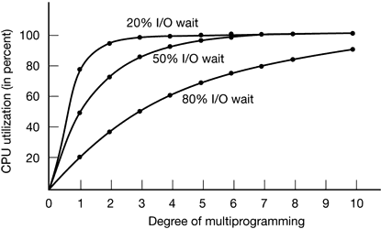
Virtual Memory
Multiprogramming has direct relationship with degree of CPU utilization
  Suppose a process spends a fraction of p of its time in I/O wait state.
  Then, the probability of n processes being all in wait state at the same time is p^{n}
  ➔The CPU utilization is 1 – p^{n}
  Thus, the more processes in the system, the higher the CPU utilization
CPU utilization as a function of the number of processes in memory

Slide 28
Virtual Memory
Resident Set – parts of the program being actively used
  Remaining parts of program on disk
Is virtual memory management scheme practical?
  Does it not involve too much of a swapping and hence reduce CPU efficiency?
  On the contrary ;
    Keeping many processes increases CPU efficiency
    Practice has shown that program and data references tend to cluster
      A program tends to reference the same items. Even if same item not used, nearby items will often be referenced ⬅ Principle of Locality

Slide 29
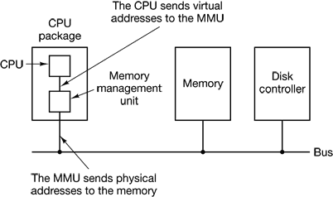
Virtual Memory
Implementation with Paging
MOV REG, 100 ; copies contents of memory address 100 to REG (or vice versa)
These program-generated addresses are called virtual addresses and form the virtual address space.
When virtual memory is used, the virtual addresses do not go directly to the memory bus. Instead, they go to an MMU (Memory Management Unit) that maps the virtual addresses onto the physical memory addresses .

Slide 30
Virtual Memory
Example - A computer that can generate 16-bit virtual addresses (0 - 64K ) and has only 32 KB of physical memory
  although 64-KB programs can be written, they cannot be loaded into memory in their entirety and run.
  A complete copy of a program’s core image, up to 64 KB, must be present on the disk, however, so that pieces can be brought in as needed.
The virtual address space is divided up into units called pages.
The corresponding units in the physical memory are called page frames.
  Transfers between RAM and disk are always in units of a page.
Considering a page size of 4KB , we have
  16 virtual pages
  8 page frames

Slide 31
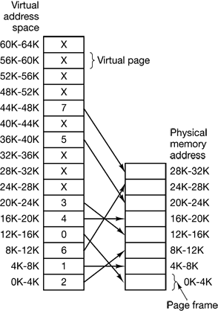
Virtual Memory

Slide 32
Virtual Memory
MOV REG,0
  virtual address 0 is sent to the MMU.
  The MMU sees that this virtual address falls in page 0 (0 to 4095), which according to its mapping is page frame 2 (8192 to 12287).
  It thus transforms the address to 8192 and outputs address 8192 onto the bus.
  The memory knows nothing at all about the MMU and just sees a request for reading or writing address 8192, which it honors. Thus, the MMU has effectively mapped all virtual addresses between 0 and 4095 onto physical addresses 8192 to 12287.
MOV REG, 8192 is effectively transformed into MOV REG, 24576 because virtual address 8192 is in virtual page 2 and this page is mapped onto physical page frame 6 (physical addresses 24576 to 28671).

Slide 33
Virtual Memory
MOV REG, 32780
  byte 12 within virtual page 8 (starting at 32768)
  the MMU notices that the page is unmapped and causes the CPU to trap to the OS.
    ➔page fault
  OS picks a little-used page frame and writes its contents back to the disk.
  OS then fetches the page just referenced into the page frame just freed, changes the map, and restarts the trapped instruction
    if page frame 1 is evicted, the OS
      would load virtual page 8 at physical address 4K
      would mark virtual page 1’s entry as unmapped, to trap any future accesses to virtual addresses between 4K and 8K,
      would replace the cross in virtual page 8’s entry with a 1

Slide 34
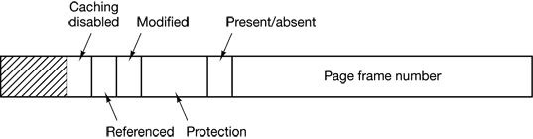
Virtual Memory
Virtual pages are mapped onto page frames using Page Tables.
Page layout - highly machine dependent
Present/absent bit shows whether virtual page is in memory
Protection bits tell what kinds of access are permitted/W, RO,..)
Modified bit keep track of page usage
Referenced bit is set whenever a page is referenced, either for reading or writing.
Caching disabled field - allows caching to be disabled for the page.

Slide 35
Virtual Memory
Two major issues must be faced:
  the page table can be extremely large
    32 bits virtual address with a 4-KB page size ➔ 1M entries
    64-bit virtual address with a 4-KB page ➔ 4.6.. x 10¹⁵ entries
    Some systems put page tables in virtual address space
  the mapping must be fast.
    the virtual-to-physical mapping must be done on every memory reference.
    A typical instruction has an instruction word, and often a memory operand as well.
    ➔ it is necessary to make 1, 2, or sometimes more page table references per instruction

Slide 36
Virtual Memory
TLB (Translation Look Aside Buffers)
  Keeping the page tables in memory has an enormous impact on performance due to their large size
  This problem can be overcome by using a device, called a TLB (Translation Lookaside Buffer) or sometimes an associative memory
    TLB maps virtual addresses to physical addresses without going through the page table ⬅ caches recently translated entries
    usually inside the MMU and consists of a small number of entries ( normally has 64 to 1,024 entries)
    Introduced based on the observation that most programs tend to make a large number of references to a small number of pages thus only a small fraction of the page table entries are heavily read; the rest are barely used at all
Valid | Virtual page | Modified | Protection | Page frame
1 | 140 | 1 | RW | 31
1 | 20 | 0 | R X | 38
1 | 130 | 1 | RW | 29
⬅ If page # =20, the output frame will be 38

Slide 37
Virtual Memory
Inverted Page Tables
  Traditional page tables - require one entry per virtual page
    If the address space consists of 2⁶⁴ bytes with 4096 bytes per page, we need a page table with 2⁵² entries and if each entry is 8 bytes, the table is over 30 million GB⬅ too much!!!
  One solution to such situations is using inverted page table
    In this design, there is one entry per page frame in real memory, rather than one entry per page of virtual address space.
    For example, with 64-bit virtual addresses, a 4-KB page, and 256 MB of RAM, an inverted page table only requires 65,536 entries.
    If each entry is 8 bytes , the table will be only 0.5 MB
    The entry keeps track of which (process, virtual page) is located in the page frame and can be created by using a hash function.

Slide 38
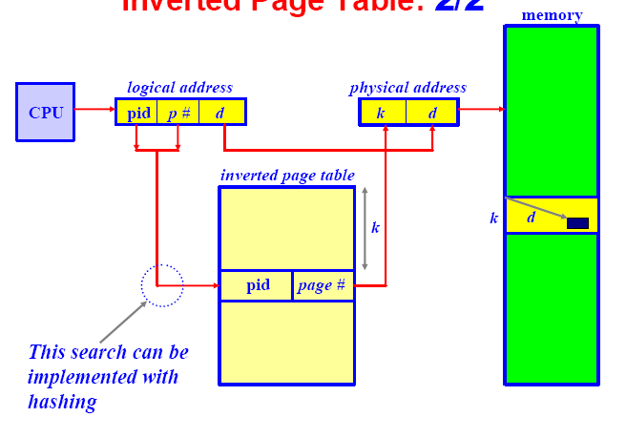
Virtual Memory

Slide 39
Virtual Memory
Does a paging system have fragmentation?
  No external fragmentation because un-used page frames can be used by the next process.
  Have internal fragmentation because the address space is divided into equal size pages, all but the last one will be filled completely. Thus, the last page contains internal fragmentation

Slide 40
Virtual Memory
Implementation with Segmentation
VM implementation with paging is one-dimensional
  virtual addresses go from 0 to some maximum address, one address after another.
  However, for many problems, having two or more separate virtual address spaces may be much better than having only one.
  Example, a compiler has many tables that are built up as compilation proceeds, possibly including:
    source text being saved for the printed listing (on batch systems)
    symbol table, containing the names and attributes of variables
    table containing all the integer and floating-point constants used
    parse tree, containing the syntactic analysis of the program
    stack used for procedure calls within the compiler

Slide 41
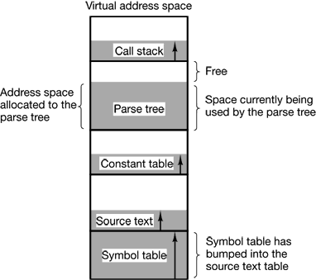
Virtual Memory
  the first four tables grows continuously as compilation proceeds. The last one grows and shrinks in unpredictable ways during compilation.
⬅Allocation of the tables using paging

Slide 42
Virtual Memory
Consider what happens if a program has an exceptionally large number of variables but a normal amount of everything else.
  The chunk of address space allocated for the symbol table may fill up, but there may be lots of room in the other tables.
    The compiler could simply issue a message saying that the compilation cannot continue due to too many variables( not fair because unused space is left in the other tables)
    Play Robin Hood- take space from the tables with an excess of room and give it to the tables with little room.
      analogous to managing one’s own overlays—a nuisance
  Solution is to provide the machine with many completely independent address spaces, called segments.
  Each segment consists of a linear sequence of addresses, from 0 to some maximum.
    Different segments may, and usually do, have different lengths
    Segment lengths may change during execution
    segments are usually very large so segment fill up is rare

Slide 43
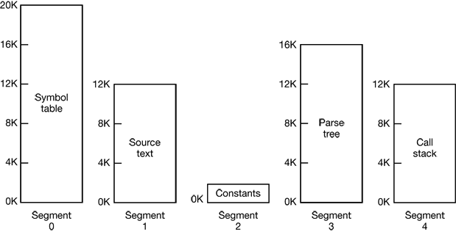
Virtual Memory
Implementation of the previous example with segmentation

Slide 44
Virtual Memory
A segment is a logical entity, which the programmer is aware of and uses as a logical entity.
A segmented memory
  Simplifies the handling of data structures that are growing or shrinking
  If the procedure in segment n is subsequently modified and recompiled, no other procedures need be changed (because no starting addresses have been modified), even if the new version is larger than the old one.
  Facilitates sharing procedures or data between several processes
  A programmer can enforce different kinds of protection for different segments

Slide 45
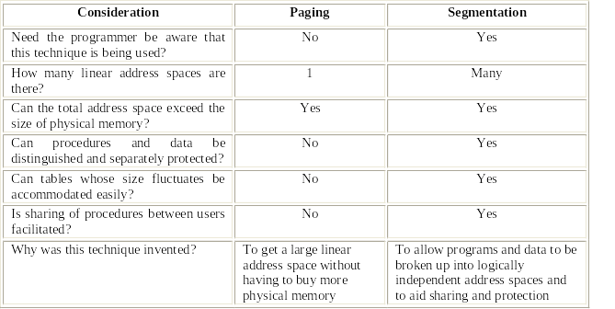
Virtual Memory
Paging Vs segmentation

Slide 46
Virtual Memory
Most modern system use both paging and segmentation together because
  Paging results in no external fragmentation and is easier to manage memory since all items are the same size +
  Segmentation is easier to manage growing data structures and facilitates sharing
  E.g. Pentium architecture
  Each segment broken up into pages
  Address Translation
    Do segment translation
    Translate that address using paging
  Windows – Uses both
  Linux
    Uses paging for virtual memory
    Uses segments only for privilege( kernel code, kernel data , user code, user data, task state segment, default LDT segment )
Log. Add
Lin. Add
Paging unit
Phy. Ad
Physical memory
Segmentation Unit
CPU

Slide 47
Virtual Memory
OS Policies( in regard to memory management )
General Decisions to make:
  Support virtual memory?
  Paging, Segmentation, or both?
  Memory management algorithms
Decisions about virtual memory
  Fetch Policy – When to bring a page in
    When needed or in expectation of need?
  Placement – Where to put it
  Replacement – What to remove to make room for a new page
  Resident Set Management – How many pages to keep in memory
    Fixed # of pages or variable?
    Reassign pages to other processes?
  Cleaning Policy – When to write a page to disk
  Load Control – Degree of multiprogramming

Slide 48
Virtual Memory
Fetch Policy
  Demand Paging – Load the page when a process tries to reference it
    Tends to produce a flurry of page faults early, then settles down
    Commonly used
  Pre-paging – Bring in pages that are likely to be used in the near future
    Try to take advantage of disk characteristics
      Generally more efficient to load several consecutive sectors/pages than individual sectors due to seek, rotational latency
    Hard to correctly guess which pages will be referenced
    Easier to guess at program startup
    May load unnecessary pages

Slide 49
Virtual Memory
Placement Policy
  Trivial in a paging system ( all pages are equal )
  Best-fit, First-Fit, or Next-Fit can be used with segmentation
Replacement Policy
  Which page to replace when a new page needs to be loaded
  The fewer number of page faults a technique generates, the better the algorithm is
  Tends to combine several things:
    How many page frames are allocated
    From pages being considered, selecting one page to be replaced
    Replace only a page in the current process, or from all processes

Slide 50
Virtual Memory
  Frame Locking
    Require a page to stay in memory
      E.g. O.S. Kernel and Interrupt Handlers, Real-Time processes, Other key data structures
    Implemented by bit in data structures
  Basic Algorithms
    Optimal - Select the page that will not be referenced for the longest time in the future
      Limitation
        There is no way of knowing that
    Least recently used (LRU) - Locate the page that hasn’t been referenced for the longest time
      Nearly as good at optimal policy in many cases
      Limitation
        Must keep a ordered list of pages or last accessed time for all pages (scanning and updating takes time )

Slide 51
Virtual Memory
    First in, First out- remove the page that has been in memory for long
      Easy to implement
      Limitation
        It may remove an important and heavily used process
    Clock Algorithm – We think of pages as circular buffer and keep a pointer to the buffer and a bit to indicate use
      Set a use bit when loaded or used
      When a page frame is needed,
        we examine the page under the pointer
        If its use bit is 0, we replace it
        Otherwise, we clear the use bit and advance
      Gives a performance close to LRU with low overhead of FIFO

Slide 52
Virtual Memory
    The Second Chance Algorithm- looks for an old page that has not been referenced in the previous clock interval and replaces that page.
    Working Set Page Replacement Algorithm – finds a page that is not in the working set and evicts it.
    Working Set Clock Page Replacement Algorithm –
  Which one is good?
    As seen above each of them are good in some way . But generally the fewer number of page faults an algorithm generates, the better the algorithm it is.
    Let p be the probability of a page fault ( p usually is between 0 and 1 ,i.e., 0 ≤ p ≤1)
    Effective access time is
    (1- p) x memory access time + p x page fault time
  ➔ page fault rate p should be small

Slide 53
Virtual Memory
  Global or Local Replacement ?
    Global replacement allows a process to select a victim from the set of all page frames, even if the page frame is currently allocated to another process.
      the number of frames allocated to a process may change over time
      a process cannot control its own page fault rate, because the behavior of a process depends on the behavior of other processes.
      throughput is usually higher, and hence commonly used
    Local replacement requires that each process selects a victim from its own set of allocated frames.
      the number of frames allocated to a process is likely constant
      A process does not have the opportunity of using other less used frames ➔Performance may be lower

Slide 54
Assignment
Compare and Contrast
  Fixed partitioning
  Dynamic partitioning
  Virtual Memory Paging
  Virtual Memory Segmentation
  What is overlay?
    Which memory management technique uses overlay

